Slide 1
A Presentation on
“ADVANCED SAFETY HELMET FOR WORKERS ”
Mrunal Jadhav ( BEENTC25)
Niraj Mistri ( BEENTC37)
Akansha Pole ( BEENTC53 )
PCET’S PIMPRI CHINCHWAD COLLEGE OF ENGINEERING AND RESEARCH,
Laxmi Nagar, Ravet, PUNE - 412 101.
ACADEMIC YEAR :2021-22

Slide 2

Outline of Presentation
Content
Introduction
Literature Survey
Gap Identification
Aim/ Problem Statement
Objectives
Methodology
Results
Component
Advantages & Disadvantages
Conclusion
References

Slide 3
Introduction
The mining industry has the highest incidence of occupational deaths among all industries
There are many case studies behind underground mines.
To overcome all these disasters, we have developed a better communication technology which has to be employed for an intelligent sensing and warning system.
Safety is the most vital part of any type of industry.
The risks are increasing in case of coal industries.

Slide 4
Literature Review
Sr. No. | Authors and Year of Publication | Journal Name | Methodology Used | Advantages | Disadvantages
1 | Yosoon Choi And Yeanjae Kim Published: 29 May 2021 | Applications of Smart Helmet in Applied Sciences | IOT | Smartly use the wireless sensor network to make the the helmet and put record the data | Less accuracy
2 | RevindranR.; Vijayaraghavan H. Bangalore, India, 19–22 September 2018; | Smart helmets for Safety in Mining Industry. | IOT | Two sections for monitoring the data reduces the work load | Complicated hardware circuit make helmet heavy

Slide 5
Literature Review
Sr. No. | Authors and Year of Publication | Journal Name | Methodology Used | Advantages | Disadvantages
4 | Punam S. Tajane,Shrutia B. Shelke, Sonal B.Sadgir, Archana N. Shelke Issue: 04 |Apr 2020 | International Research Journal of Engineering and Technology (IRJET) | ZIGBEE technology | IOT system effectively works | High cost
5 | Nisha Dube1, Prof. K.S.Ingle Issue 1, January 2016. | “Intelligent Mining: A Monitoring and Security System for Coal Mine Workers” | A real time monitoring system is developed to provide clearer communication using ZIGBEE between mine workers. | A real time monitoring system is developed to provide clearer and more point to point perspective of the underground mine system and also provide reliable communication using ZIGBEE between mine workers. | Because of open wiring used in the system make system dangerous

Slide 6
Gap Identification / Finding from Survey
Primitive procedures of monitoring a mine's air can be followed back to the utilization of canaries and different creatures to ready diggers when the climate gets to be lethal.
Incorporating ventilation monitoring systems empowers a mine to insightfully roll out ventilation improvements in view of the far reaching information given by the monitoring systems.
Sudden changes in the ventilation system are identified by the monitoring system, permitting quick move to be made. New and creating correspondence and following systems can be used to monitor mines more proficiently and transfer the information to the surface.

Slide 7
Gap Identification
The progression of technology has allowed mine monitoring techniques to become more sophisticated, yet explosions in underground coal mines still occur.
The safety issues of coal mines have gradually turned into a major concern for the society and nation. The occurrence of disasters in coal mines is mainly due to the harsh environment and variability of working conditions .
So, it makes the implementation of mine monitoring systems essential for the safety purpose.
Wired network systems used to be a trend for traditional coal mines, which have really played a significant role in safely production in coal mines.

Slide 8
Problem Statement
Aim :
“The main aim of this project is to developed IOT Based
Tracking and working smart safety helmets”

Slide 9
Objectives
The objectives of the proposed projects are :
To avoid the conditions of environment changes.
To maintain security is a fundamental aspect of all.
To avoid accidents of workers working in mining industries.

Slide 10

Proposed Methodology : Block Diagram
Power Supply
Raspberry Pi
Temperature sensor
Buzzer
Heart beat sensor
LCD
Smoke sensor
Wi-Fi module

Slide 11
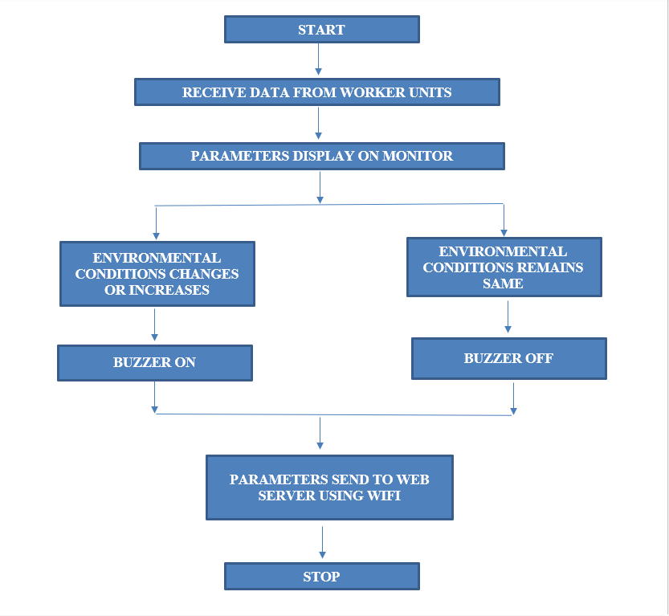
Proposed Methodology : Flow Chart /Algorithm
BUZZER BLOW

Slide 12
Proposed Methodology : Explanation
Safety is the most vital part of any type of industry. In the mining industry safety and security is a fundamental aspect of all. To avoid any types of accidents mining industry follows some basic precautions.
Still accidents take place in underground mines due to rise in temperature, increased water level, and methane gas leakage. Here we provide safety to worker.
When worker in danger he can press panic switch inform security. To enhance safety in underground mines, a reliable communication system must be established between workers in underground mines and fixed ground mine system
. The communication network must not be interrupted at any moment and at any condition. A cost effective wireless mine supervising system with early-warning intelligence is proposed in this project. Worker status can be monitor over IOT.

Slide 13
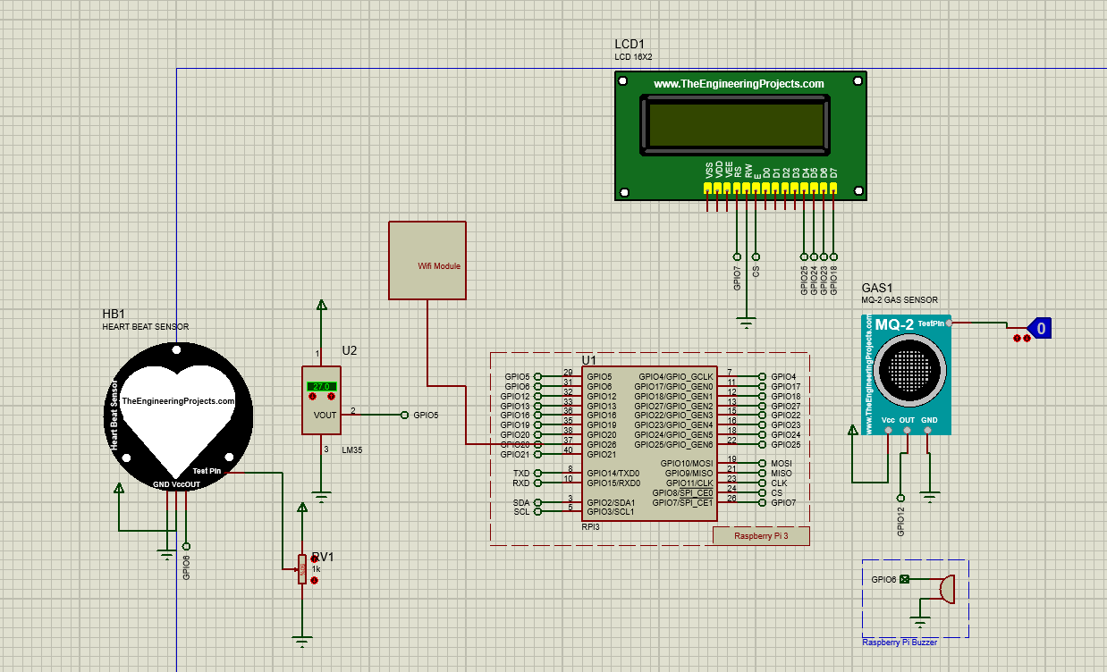
Proposed Methodology : Circuit Diagram

Slide 14
Proposed Methodology :Results
The dangerous gases are sensed using gas sensors. Every time the poisonous gas is sensed the control valve gets opened for providing oxygen companion. In this project the raspberry pi is the major controller.System is able to monitor the health conditions of the worker as well as surrounding conditions. Also, if the worker health disturbed system will send the alert message. In the system temperature sensor, heartbeat sensor, smoke sensor , buzzer, WIFI module is used. Sensors will read the values and send it to the controller . If the conditions of environment changes like if smoke at the workers end increases system send alert. Hence our system is helpful for the worker.
Following are the results depending upon the given conditions for temperature sensor, heartrate sensor, gas sensor

Slide 15
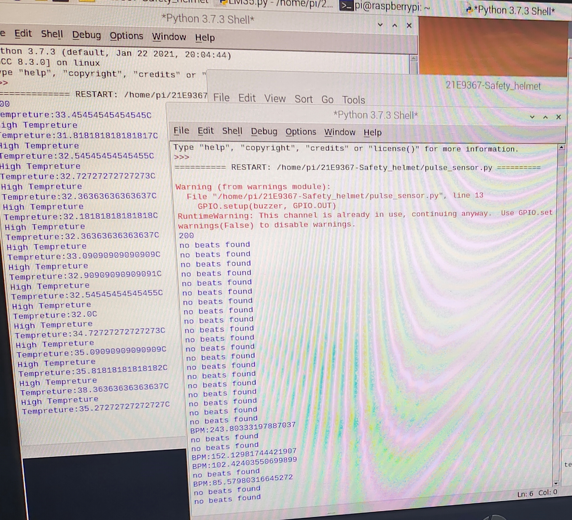
Proposed Methodology :Results
Given results are for temperature sensor and heart rate sensor

Slide 16
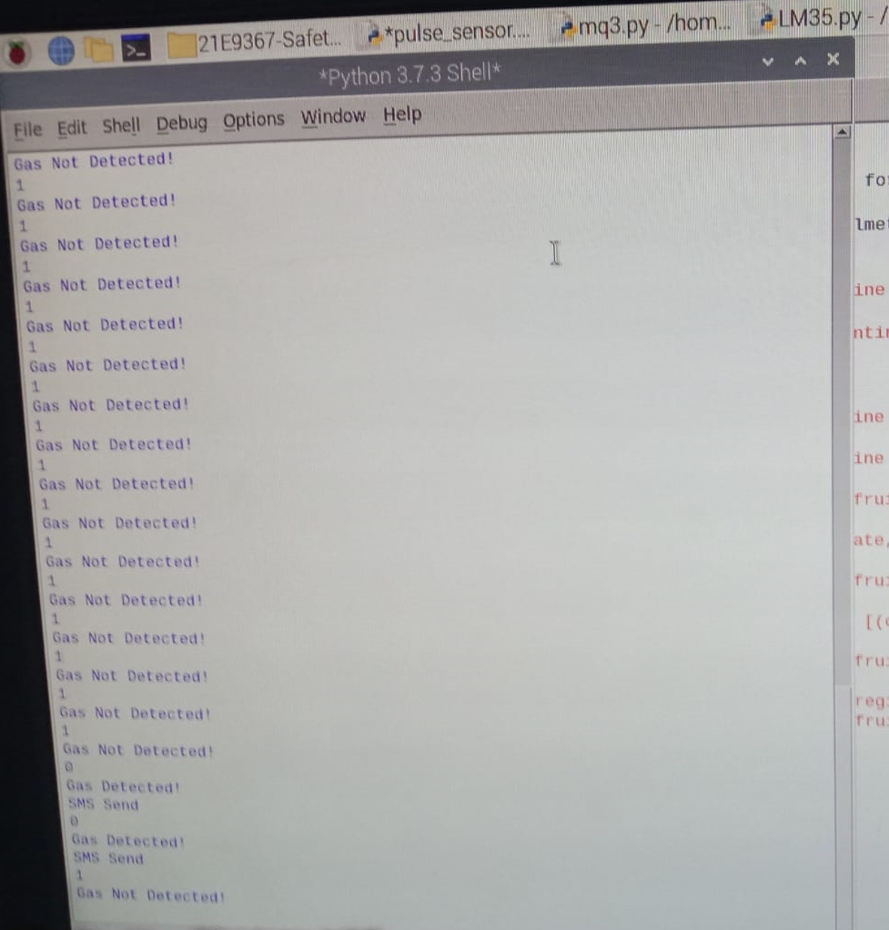
Proposed Methodology :Results
Given results are for gas sensor ,the results are shown with the help of python software, where the conditions are applied in the code. If the purposed system satisfies the condition the results will be displayed on the screen

Slide 17
Proposed Methodology : Implementation System Details
The implementation system details are given in following table:
Sr. No. | System | Name of System Tools
1 | Microsoft visual studio Community | Programming Language: C
2 | Cloud | Think Speak
3 | Stimulation Software | Proteus 8
4 | Operating System | Windows OS

Slide 18
Proposed Methodology : Component
1. Raspberry Pi:
Specifications:
Processor: Broadcom BCM2837B0, Cortex-A53 64-bit SoC @ 1.4GHz
Memory: 1GB LPDDR2 SDRAM
Access: Extended 40-pin GPIO header
SD card support: Micro SD format for loading operating system and data storage
2. Temperature Sensor:
Specification:
Supply voltage: –0.2 35 V
Output voltage: –1 6 V
Output current: 10 mA
Maximum Junction Temperature: TJmax 150 °C

Slide 19
Proposed Methodology : Component
3. Heart Beat Sensor
Specifications:
Biometric Pulse Rate or Heart Rate detecting sensor
Plug and Play type sensor
Operating Voltage: +5V or +3.3V
Current Consumption: 4mA
Inbuilt Amplification and Noise cancellation circuit.
Diameter: 0.625”
Thickness: 0.125” Thick
4.Analog-digital Converter:
Specification:
the ADS1115 provides 16-bit precision at 860 samples/second over I2C.
The chip can be configured as 4 single-ended input channels or two differential channels. As a nice bonus, it even includes a programmable gain amplifier, up to x16, to help boost up smaller single/differential signals to the full range.

Slide 20
Proposed Methodology : Component
5. Buzzer
Specifications:
Rated Voltage: 6V DC
Operating Voltage: 4-8V DC
Rated current: <30mA
Sound Type: Continuous Beep
Resonant Frequency: ~2300 Hz
Small and neat sealed package
Breadboard and Perf board friendly
6. Gas Sensor
Specifications:
Smoke detectors are usually housed in plastic enclosures, typically shaped like a disk about 150 millimeters (6 in) in diameter and 25 millimeters (1 in) thick, but shape and size vary. Smoke can be detected either optically (photoelectric) or by physical process (ionization). Detectors may use one or both sensing methods.

Slide 21
Advantages of Proposed System
Assuring miners safety in case of mining accidents that occurs due to increase in temperature, pressure, force.
To help the coal miners inside the mines to communicate with the outside world.
To monitor the conditions inside the mines and intimate the miners in case of emergency.
GPS is used to track the position of miners.
Alerting the miners whenever the helmet is removed.

Slide 22
Disadvantages of Proposed System
Some sensors, such as cameras and global positioning systems attached to smart helmets have potential elements of privacy invasion. To date, there has been in-sufficient research on the security and privacy of data collected by smart helmets through sensors.
• Smart helmets mainly use inexpensive and lightweight sensors. Therefore, there is a possibility that the sensor malfunctions frequently, and a false alarm occurs.

Slide 23
Applications
Mining industries
Construction sites
Disaster prevention
Rescue request
Police services

Slide 24
Conclusion
Thus a smart helmet for hazardous event detection, monitoring the surrounding environmental conditions and updating information and sensor data to the central console for easy tracking and providing oxygen supplements to avoid the inhalation of poisonous gases is designed.

Slide 25
Future scope
To avoid the range issues we can attach a Signal/network Catcher.
For better communication Walkie Talky can be added.
To date, there has been in-sufficient research on the security and privacy of data collected by smart helmets through sensors. It can be improved to maintain the privacy of data collection.
Small Fans

Slide 26
References
Nisha Dube1, Prof. K.S.Ingle 2 PG Student, Dept. of ECE “Intelligent Mining: A Monitoring and Security System for Coal Mine Workers”, International Journal of Advanced Research in Electrical, Electronics and Instrumentation Engineering (An ISO 3297: 2007 Certified Organization) Vol. 5, Issue 1, January 2019.
Warsha M.Choudhari Professor, Datta Meghe, “Coal Mine Security System ” International Journal of Applied Information Systems (IJAIS) – ISSN : 2249-0868 Foundation of Computer Science FCS, New York, USA Volume 4– No.10, December 2018.
Prof. Himanshu K. Patel, Deep H. Desai, Tanvi G. Badheka,“GSM Based Flexible Calling System ”International Journal of Engineering Trends and Technology (IJETT) - Volume4Issue4- April 2020 .
Vandana,PG Scholar,“Development of Coalmine Safety System Using WirelessSensor Network” Department of Electronics and Communications Engineering Sri Vasavi Engineering College, Tadepalligudem Andhra Pradesh, India ,2019 .
Applications of Smart Helmet in Applied Sciences: A Systematic Review Department of Energy Resources Engineering, Pukyong National University, Busan 48513, Korea; 2020

